Slide 1

Final Analysis Project
DS3213: Principles of Data Science
Daniel Mühlbauer

Slide 2
Demographic
Understanding Key Demographics

Slide 3
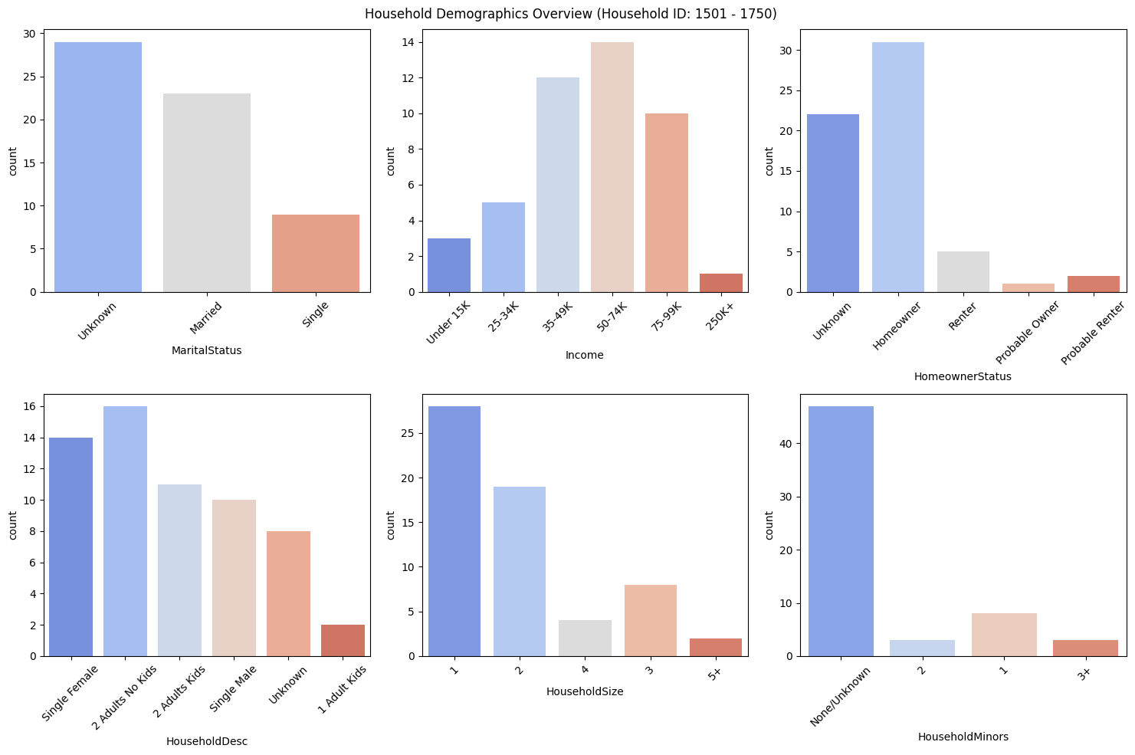

Slide 4
Demographic Overview
Key Takeaways:
Key Demographic includes the following:
50-74K Income
1-2 person household
No miners
Homeowner
Recommendations:
Tailor marketing and inventory to this market group:
Analyze industry-related reports from market research companies
Understand their drivers and needs to turn them into loyal customers
Helpful Article: https://hbr.org/2011/12/know-what-your-customers-want-before-they-do

Slide 5
Product
Understanding Key Products

Slide 6
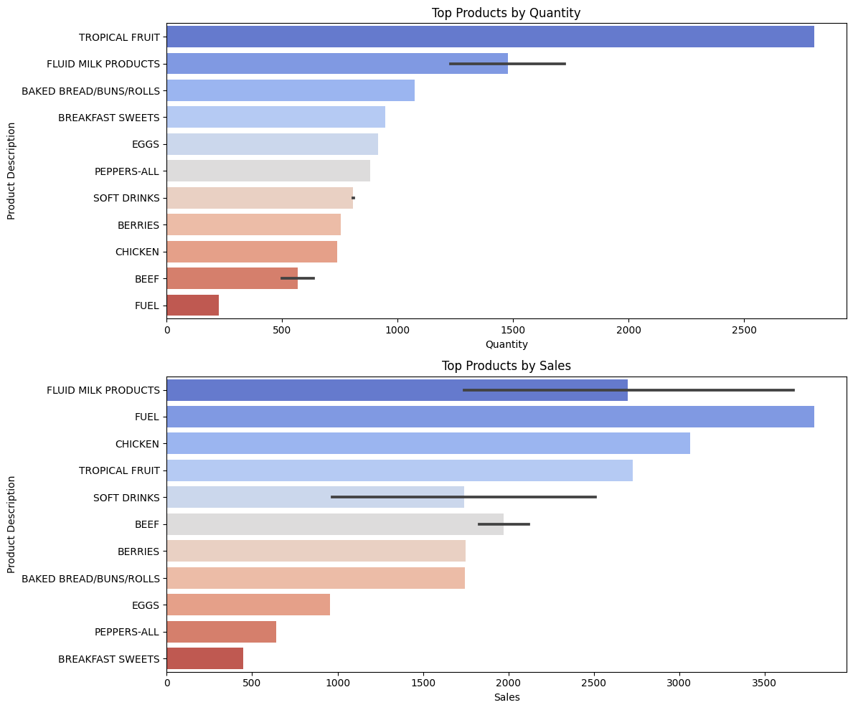
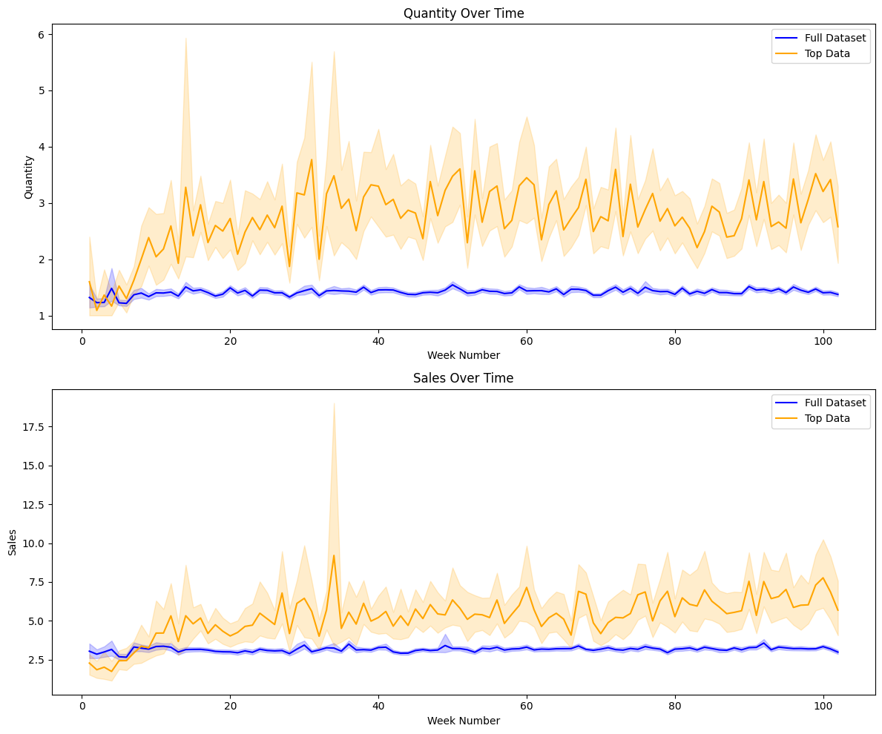

Slide 7
Product Analysis
Key Takeaway:
Highlights top products w.r.t sales value and quantity
Bigger variance between total mean and quantity compared to total mean and sales value
Indicates that quantity impacts revenue more than sales
Recommendation:
Tailor marketing in a way that reflects this insight to drive quantity. Following ideas:
Bulk purchase discounts where customers get higher discounts the more they buy
Design loyalty programs that encourage quantity
Design promotional deals that encourage high-quantity purchasing
Helpful Article: https://www.masterclass.com/articles/volume-pricing

Slide 8
Department
Understanding which department drives sales

Slide 9
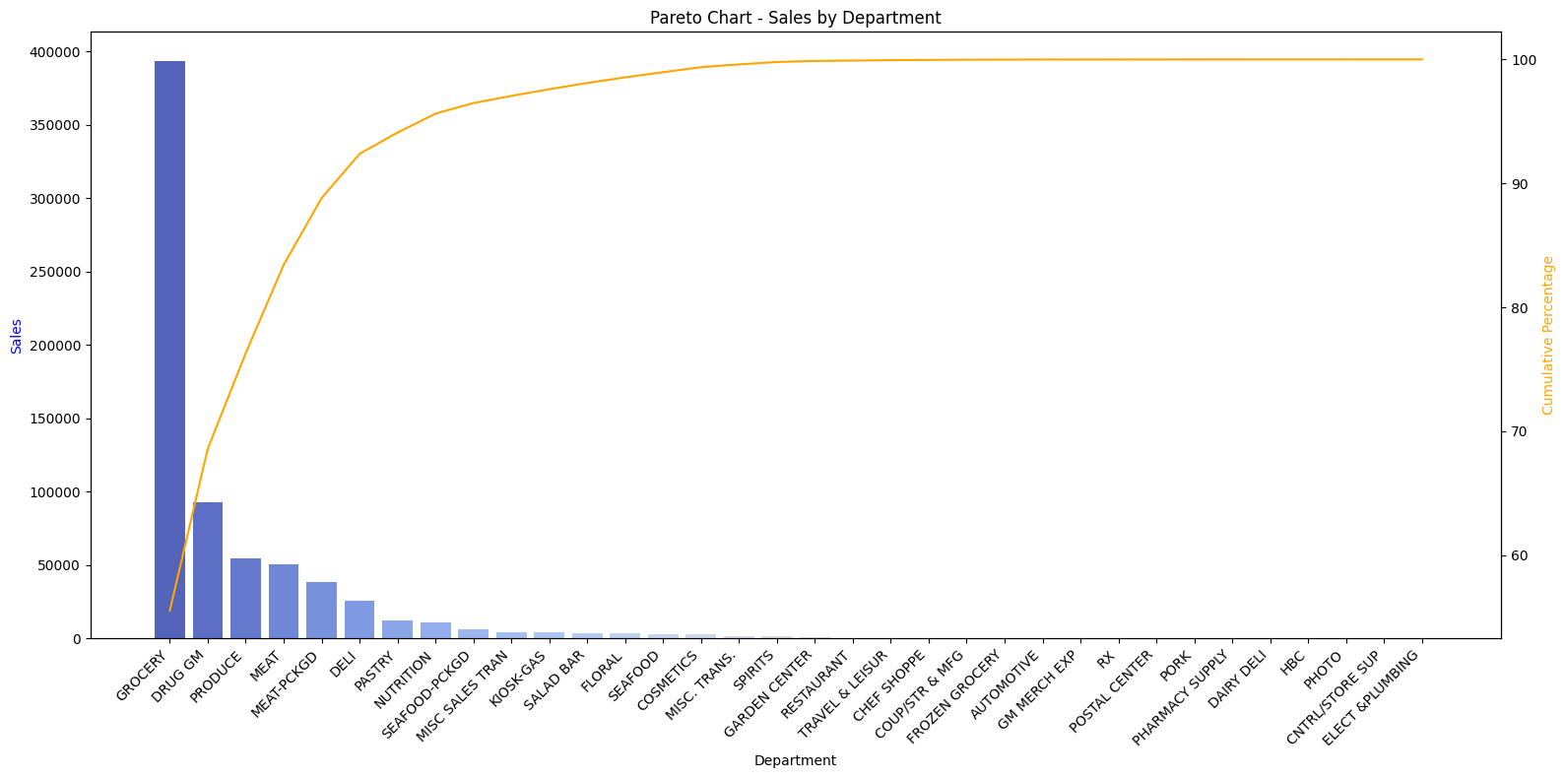

Slide 10
Department Analysis
Key Takeaway:
Top 4 Departments (11% total) drive >80% of Sales
Grocery
Drug GM
Produce
Meat
Recommendation:
Always ensure that the top 4 departments are properly stocked as they drive business revenue. Could focus on the following ideas:
Inventory Optimization
Supply Chain Waste Reduction
Supply Chain Resiliency
Helpful Article: https://hbr.org/2022/12/a-better-way-to-match-supply-and-demand-in-the-retail-supply-chain

Slide 11
Campaigns
Understanding the effectiveness of campaigns

Slide 12
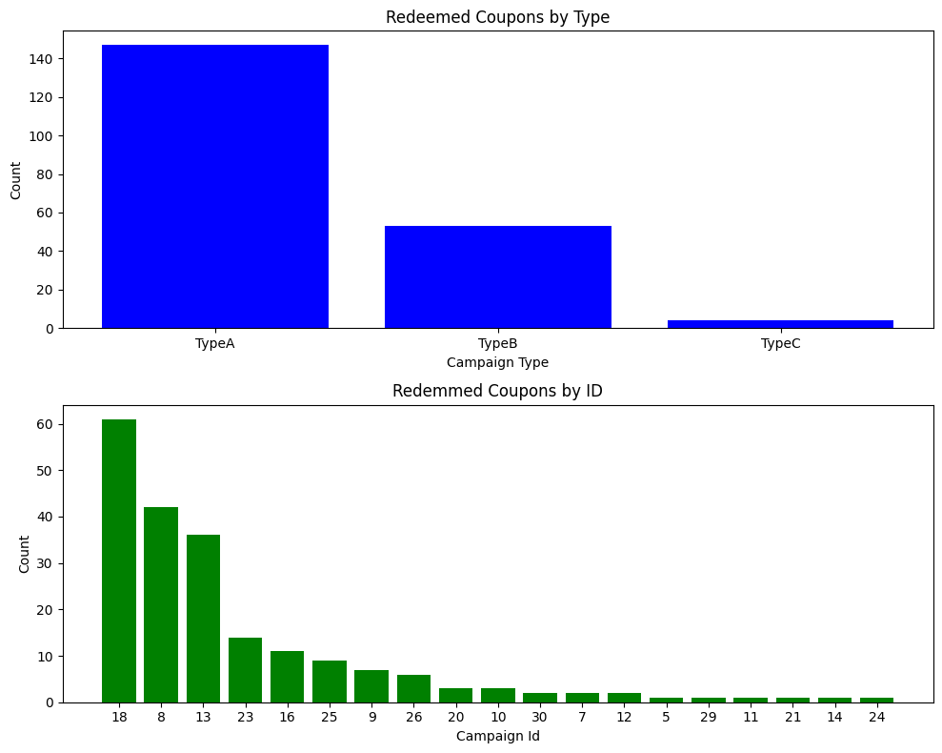
Redeemed Coupons Overview

Slide 13
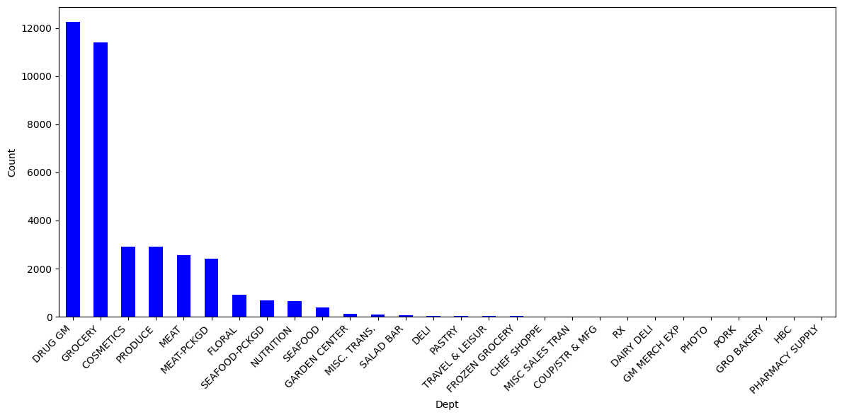
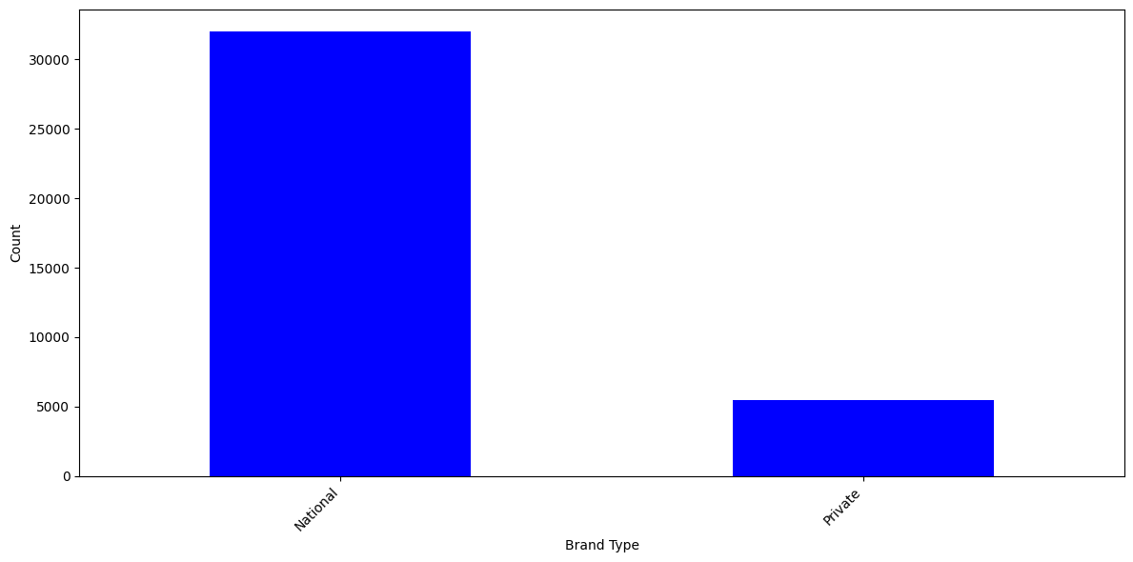
CampaignID 18 Overview
MAKEUP AND TREATMENT 2406
HAIR CARE PRODUCTS 1857
FRZN MEAT/MEAT DINNERS 1336
CHEESE 1107
BEEF 1107
ICE CREAM/MILK/SHERBTS 980
ORAL HYGIENE PRODUCTS 939
FROZEN PIZZA 926
LUNCHMEAT 800
HAND/BODY/FACIAL PRODUCTS 782

Slide 14
Camapaign Analysis
Key Takeaway:
2 Successful Types
Type A (Top 3 Campaigns)
Type B (Next 3 Campaigns)
Type A as the most effective campaign – reviewing the campaignID 18 it has the following success factors:
Focus on Drug GM and Groceries
Focus on National Brands
Top 3 Products are: makeup and treatment, hair care products, frozen meat/meat dinners
Recommendation:
Drive Campaigns that are aligned with most successful departments regarding sales volume
Especially focus on hygiene products and “easy” foods

